Slide 1

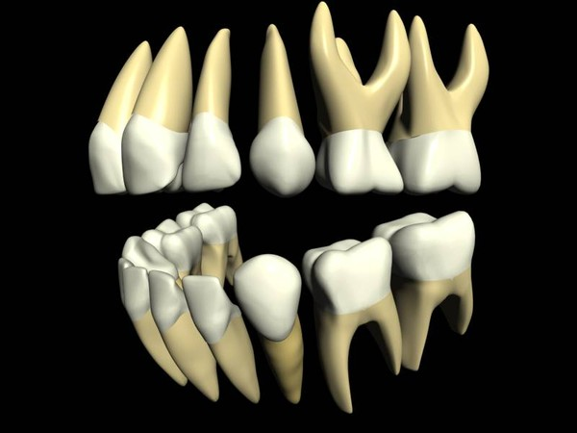
RUNGTA COLLEGE OF DENTAL SCIENCES & RESEARCH
Normal Anatomy of Tooth
DEPARTMENT OF ORAL PATHOLOGY

Slide 2
Specific learning Objectives
Core areas* | Domain ** | Category #
Parts of tooth | COGNITIVE | MUST KNOW
Structure of tooth Dentitions in humans Classes of teeth | COGNITIVE COGNITIVE COGNITIVE | MUST KNOW MUST KNOW MUST KNOW
Surfaces of teeth Functions of teeth | COGNITIVE COGNITIVE | MUST KNOW MUST KNOW

Slide 3
Contents
Parts of tooth
Structure of tooth
Dentitions in humans
Classes of teeth
Surfaces of teeth
Functions of teeth

Slide 4
Parts of tooth
Any tooth has two main parts :
Crown
Root
Crown – portion of tooth that projects above the gum line into the oral cavity
Root – portion of tooth that is embedded in the jaw bone & anchors the tooth

Slide 5
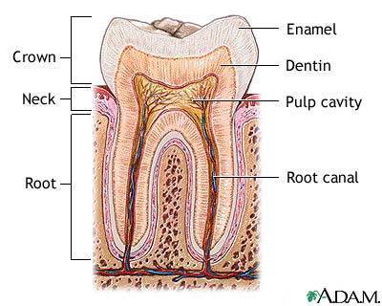

Slide 6
Structure of tooth
3 Hard / mineralized tissues
ENAMEL – outer covering of tooth crown
CEMENTUM – outer covering of tooth root
DENTIN – Inner layer beneath enamel &
cementum covering the pulp
1 Soft tissue
PULP – central core of tooth

Slide 7
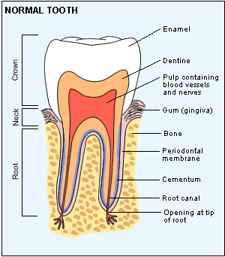

Slide 8
Enamel
Hardest substance of human body
Protective covering over the tooth crown
Not present in root portion
Dentin
Forms the major bulk of tooth
Present both in crown & root portion

Slide 9
Cementum
Hard avascular tissue
Covers root portion of tooth
Pulp
Specialized connective tissue that carries blood & nerve supply to the tooth
Protected by rigid dentin walls all around it
2 parts :
pulp chamber (present in crown)
root canal (present in root)

Slide 10
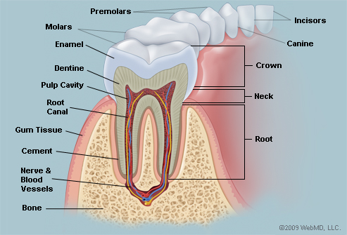

Slide 11
Dentitions in humans
2 sets of teeth
Condition called as diphyodonty
Primary (or) Deciduous dentition
Secondary (or) Permanent dentition

Slide 12
Primary (or) Deciduous dentition
Primary = they are first set of teeth to appear
Deciduous = they shed/fall off naturally
Other names – Milk teeth / Baby teeth
They emerge into oral cavity at 6 months
Consists of total 20 teeth ( 10 in each jaw)

Slide 13
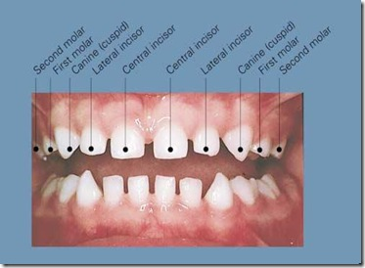
NO PREMOLARS IN DECIDUOUS DENTITION

Slide 14
Secondary (or) Permanent dentition
Secondary = they replace the primary teeth
Permanent = they don’t shed / fall off as in case of primary dentition
Also called succedaneous teeth – since they succeed the primary teeth.
They emerge into oral cavity at 6 years
They are 32 in number (16 in each jaw)

Slide 15
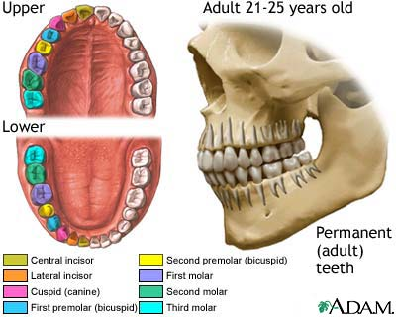

Slide 16
Classes of teeth
Depending on form & function, there are 4 classes of teeth :-
Incisors
Canines
Premolars
Molars
Note :- Premolars are found only in permanent dentition. There are no premolars in primary dentition.

Slide 17
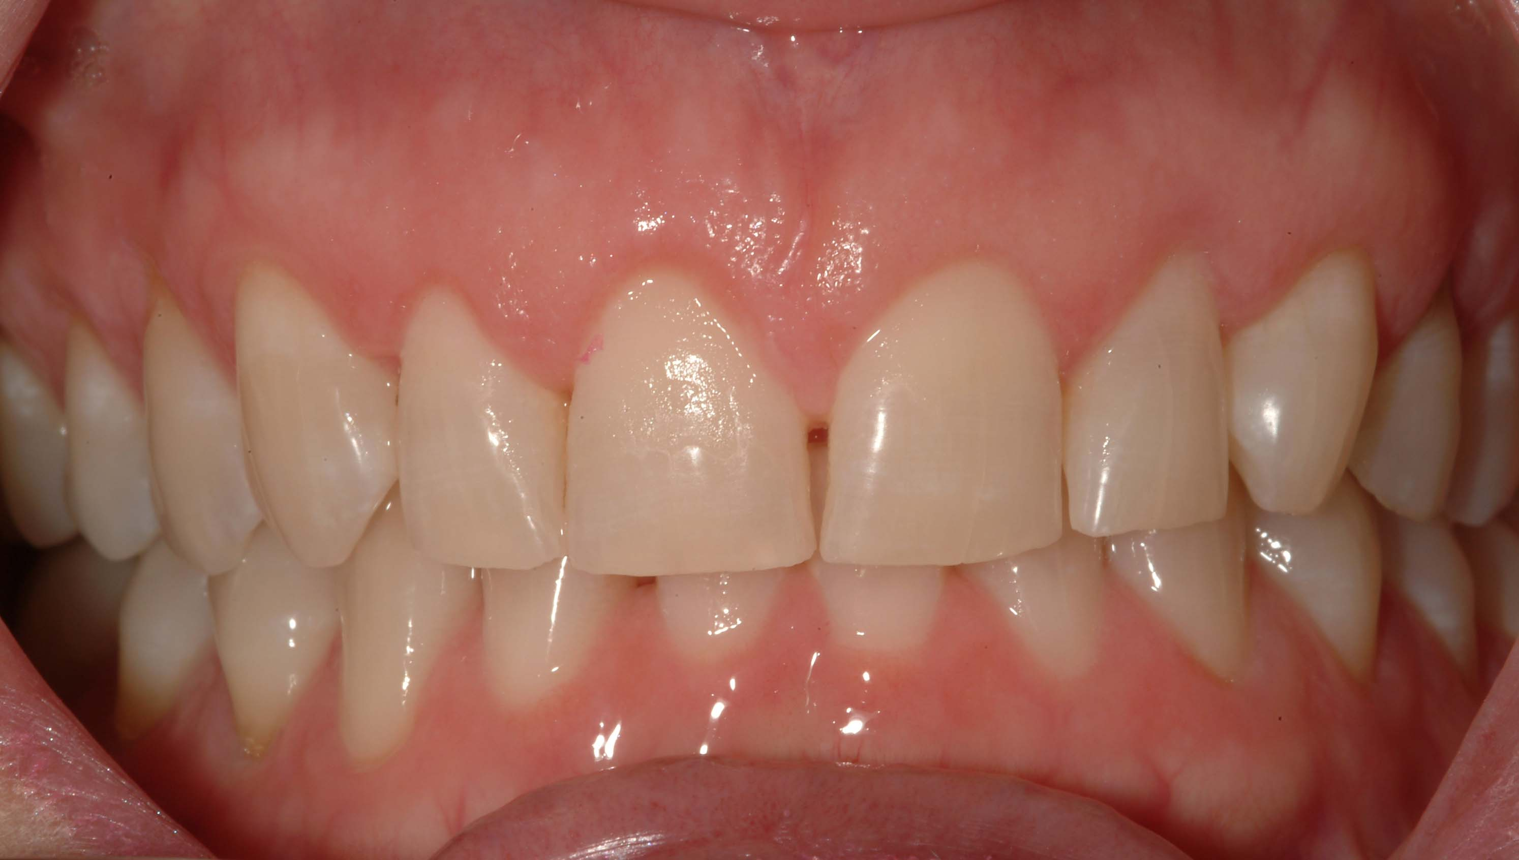
Incisors :- function is to incise. They are the “cutting teeth”
Sharp incisal edge
2 types : Central & Lateral

Slide 18
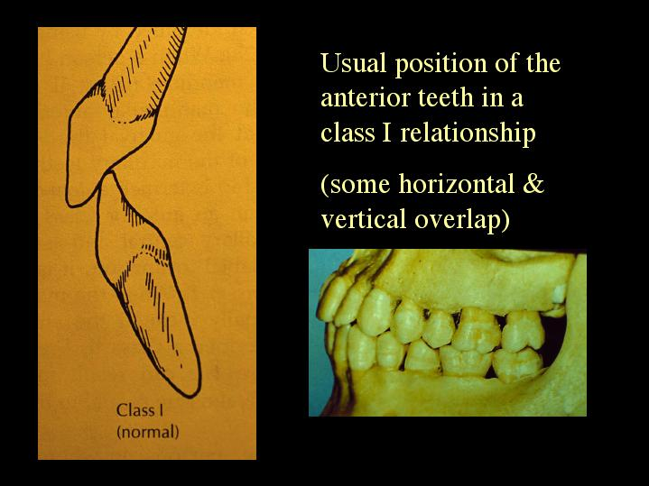
Vertical & Horizontal Overlapping
Maxillary incisors overlap mandibular incisors
Scissor action – helps in Cutting the food

Slide 19
Function :
- The incisors are shearing or cutting teeth.
(Their major function is to cut or bite food, slicing them using the sharp edge)
- They provide aesthetic appeal to the face
- They support the lips which rest on them
- They help in speech (pronunciation of certain alphabets)
- Help in guiding the jaw when mouth is closed

Slide 20
Canines :-
Corner teeth of arches
Also called cuspids (presence of single pointed cusp)
Function : prehension of food

Slide 21
Functions :
- The Canines are Tearing teeth.
(Their major function is to rip or tear food, piercing them using the sharp cusp)
- They provide aesthetic appeal to the face
- They support the lips which rest on them
- They help in speech (pronunciation of certain alphabets)
- Help in guiding the jaw when mouth is closed – help as guideposts when you move your jaw right or left
- In Carnivores : help as tool in hunting & self defense – used for prehension (seizing) of prey

Slide 22
Premolars :- also called bicuspids (presence of two cusps)
Lie in front of molars therefore “pre-molars”
2 in number – 1st & 2nd
Function : Prehension
: Grinding

Slide 23
Molars : widest teeth in arch
Function is to grind & triturate the food particles
3 in number – 1st,2nd ,3rd

Slide 24
Functions
They are grinding teeth (mastication - chew the food into small particles)
Help in sustaining the vertical dimension
Help maintain arch continuity
They give fullness to the cheek

Slide 25
Types of teeth in human dentition
Classes | Permanent dentition | Primary dentition
Incisor | Central & Lateral | Central & Lateral
Canine | Single | Single
Premolars | First & Second | NO PREMOLARS
Molars | First, Second & Third | First & Second

Slide 26
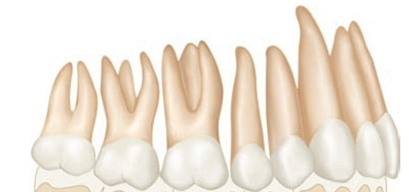
Roots
Incisors & Canines – 1 root
Premolars – 1 root
(2 roots in maxillary 1st premolar)
Maxillary molars – 3 roots
Mandibular molars – 2 roots
Cusps
Incisors – No cusp
Canines – 1 cusp
Premolars – 2 cusps
Molars – multiple (4-5) cusps

Slide 27
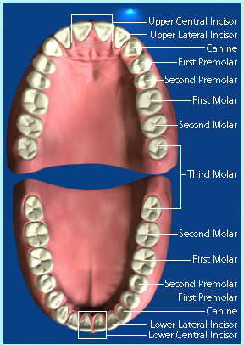
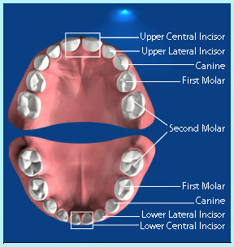

Slide 28
Incisor
+ Anteriors
Canine
Premolars
+ Posteriors
Molars

Slide 29
Arrangement in dental arches
Teeth arranged on two arches (Jaws):
Maxilla
&
Mandible
Maxillary arch – teeth in upper jaw (maxilla) are called maxillary or upper teeth
Mandibular arch – teeth in lower jaw (mandible) are called madibular or lower teeth

Slide 30
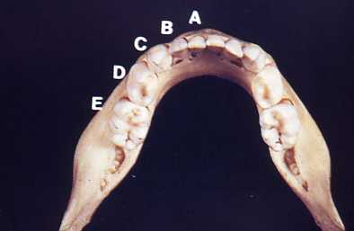
Mandibular Arch

Slide 31
Each arch consists two quadrants
Right
&
Left
Right
Left

Slide 32
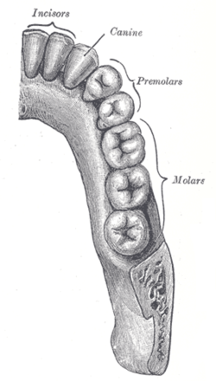
One Quadrant of the Dental Arch

Slide 33
Dental Arches and Quadrants
The midline
2
1
4
3

Slide 34
Dental Arches and Quadrants
The midline
8 teeth (Permanent)
5 teeth (Primary)
2
1
4
3

Slide 35
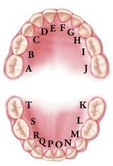
Dental Arches and Quadrants
5 teeth (Primary)
Second molar, first molar, canine, lateral Incisor, Central Incisor
2
4
3

Slide 36
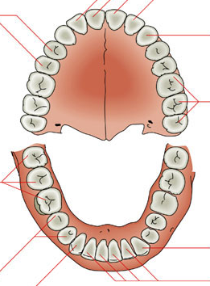
Dental Arches and Quadrants
8 teeth (Permanent)
3rd molar, 2nd molar, 1st molar, 2nd premolar, 1st premolar, canine, lateral, Central Incisor
2
4
3

Slide 37
Surfaces of teeth
Five surfaces can be recognized on the crowns of all teeth
Anterior teeth | Posterior teeth
Labial | Buccal
Lingual / Palatal | Lingual / Palatal
Mesial | Mesial
Distal | Distal
Incisal | Occlusal

Slide 38
Labial – surface towards lips (anteriors)
Buccal – surface towards cheeks (posteriors)
Lingual / Palatal – surface facing towards tongue/palate
Mesial – surface nearest to median line
Distal - surface away from the median line
Incisal / Occlusal – surface that comes in contact with those of opposing teeth

Slide 39
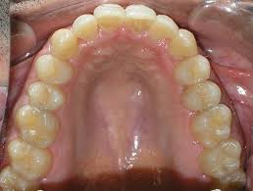
Palatal
Labial
Buccal

Slide 40
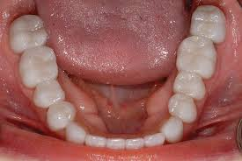
Lingual

Slide 41
M
M
D
D
M
M
D
D
M
M
D
M
D
M
M
D
D
M
D

Slide 42
Occlusal surfaces = only in premolars & molars Incisal surfaces = only in incisors & canines
o
o
o
o
o
o
o
o
i
i
i
i
i
i

Slide 43
Distal + Mesial = Proximal surfaces
Labial + Buccal = Facial surfaces

Slide 45
Tooth Numbering Systems
There are three different numbering systems used to identify the teeth in dentistry.

Slide 46
Universal Numbering System (ADA)
Palmer Notation Numbering System
Federation Dentaire Internationale Numbering System (FDI)

Slide 47
Remember that the diagram shows a mirror image
Teeth on your right are patient’s left teeth
Teeth on your left are patient’s right teeth

Slide 48
RIGHT LEFT

Slide 50
Universal Numbering System/National Numbering System
Adopted by the ADA (American Dental Association in 1968)
Most common method used in the United States
Each tooth has a different numerical or alphabet by which it is identified : Universal

Slide 51
Universal/National Numbering System for (Deciduous or Primary Teeth)
1. Teeth are identified by letters from A - T
2. Labeling takes place in a circular pattern (clockwise)
3. Start at the maxillary right 2nd molar, which is A
4. Move to the left side of the maxillary arch and assign each tooth a different letter in alphabetical order
5. The maxillary left 2nd molar is J

Slide 52
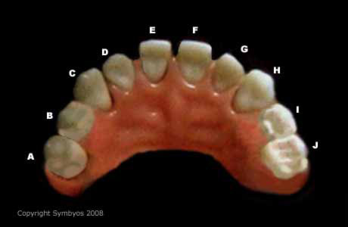

Slide 53
6. Drop down to the mandibular left 2nd molar, which is K
7. Move to the right side of the mandibular arch and assign each tooth a different letter in alphabetical order
8. The mandibular right 2nd molar is T

Slide 54
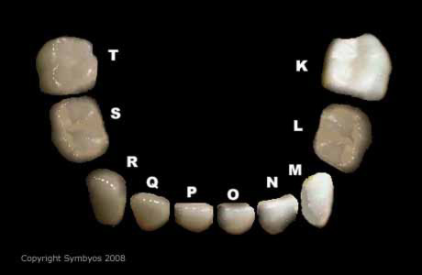

Slide 55
Primary Teeth (Dental arch)

Slide 56
Universal/National Numbering System for ( Permanent Teeth )
Teeth are numbered from 1 to 32
Start at maxillary right 3rd molar, which is 1
Move to the left side of maxillary arch and assign each tooth a different number in numerical order
Maxillary left 3rd molar is 16
Note :-
Deciduous teeth = Alphabets (ABCDE…..)
Permanent teeth = Numericals (12345….)

Slide 57
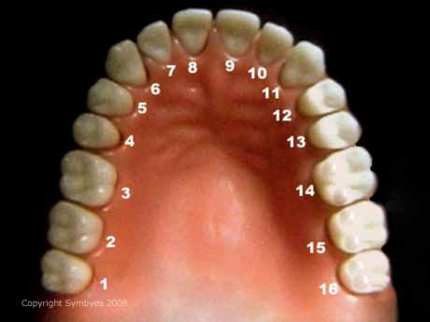

Slide 58
Drop down to mandibular left 3rd molar, which is 17
Move to right side of mandibular arch and assign each tooth a different number in numerical order
Mandibular right 3rd molar is 32

Slide 59
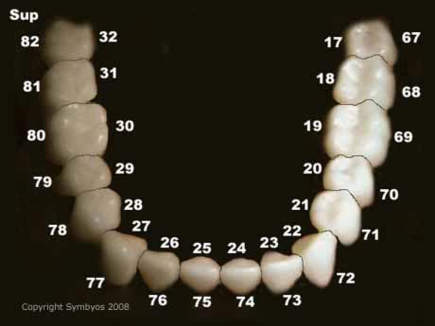

Slide 60
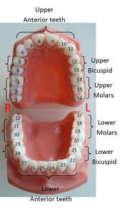

Slide 61
Palmer Notation Numbering System
Originally called the Zsigmondy system after an Austrian dentist of that name who developed the idea in 1861.
Zsigmondy Palmer system

Slide 62
Deciduous teeth
The mouth is divided into four sections called quadrants.
Each quadrant is represented by a GRID
The numbers A through E and a unique symbol (GRID or “L” shape) is used to identify the teeth in each quadrant.
The numbering runs from the center of the mouth to the back.
In the upper right quadrant tooth, alphabet A is the incisor & 2nd molar is E.

Slide 63
Maxillary
Right
Maxillary
Left
Mandibular
Right
Mandibular
Left

Slide 64
4 Quadrants
Maxillary Right
Maxillary Left
Mandibular Right
Mandibular Left

Slide 65
RIGHT LEFT

Slide 66

C = Right Maxillary Deciduous Canine
D = Left Mandibular Deciduous 1st molar

Slide 67
Permanent teeth
Numbers 1 through 8 and a unique symbol is used to identify the teeth in each quadrant.
The numbering runs from the center of the mouth to the back.
Note :-
Deciduous teeth = Alphabets (ABCDE…..)
Permanent teeth = Numericals (12345….)

Slide 68
In the upper right quadrant tooth, number 1 is the incisor.
The numbers continue to the right and back to tooth number 8, which is the third molar.
The numbers sit inside an L-shaped symbol used to identify the quadrant.

Slide 69
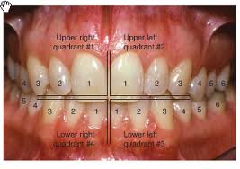

Slide 70
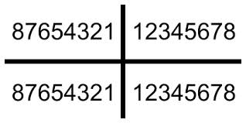
6 = Right Maxillary Permanent 1st Molar
4 = Left Mandibular Permanent 1st Premolar

Slide 71
Federation Dentaire Internationale Numbering System (FDI).
Internationally the two- digit system is used worldwide.
Each quadrant is assigned a number.
Each tooth is assigned a number.
No alphabets , only numerical designations

Slide 72
FDI for Permanent teeth
The maxillary right quadrant is assigned the number 1
The maxillary left quadrant is assigned the number 2
The mandibular left quadrant is assigned the number 3
The mandibular right quadrant is assigned the number 4
The teeth within each quadrant are assigned a number from 1 through 8
1 = central incisor
8 = third molar

Slide 73
Permanent teeth
1
2
4
3

Slide 74
Permanent teeth
18 17 16 15 14 13 12 11
21 22 23 24 25 26 27 28
48 47 46 45 44 43 42 41
31 32 33 34 35 36 37 38
The two digits have to be spelled separately
11 = one one (not eleven)
46 = four six (not forty six )

Slide 75
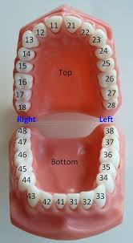
Left mandibular
34
1st premolar

Slide 76
FDI for DECIDUOUS teeth
The maxillary right quadrant is assigned the number 5
The maxillary left quadrant is assigned the number 6
The mandibular left quadrant is assigned the number 7
The mandibular right quadrant is assigned the number 8
The teeth within each quadrant are assigned a number from 1 through 8
1 = central incisor
8 = third molar

Slide 77
Deciduous teeth
5
6
8
7

Slide 78
55 54 53 52 51
61 62 63 64 65
85 84 83 82 81
71 72 73 74 75
The two digits have to be spelled separately
51 = five one (not fifty one)
75 = seven five (not seventy five )

Slide 79
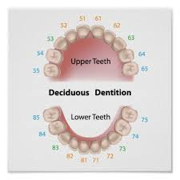

Slide 80
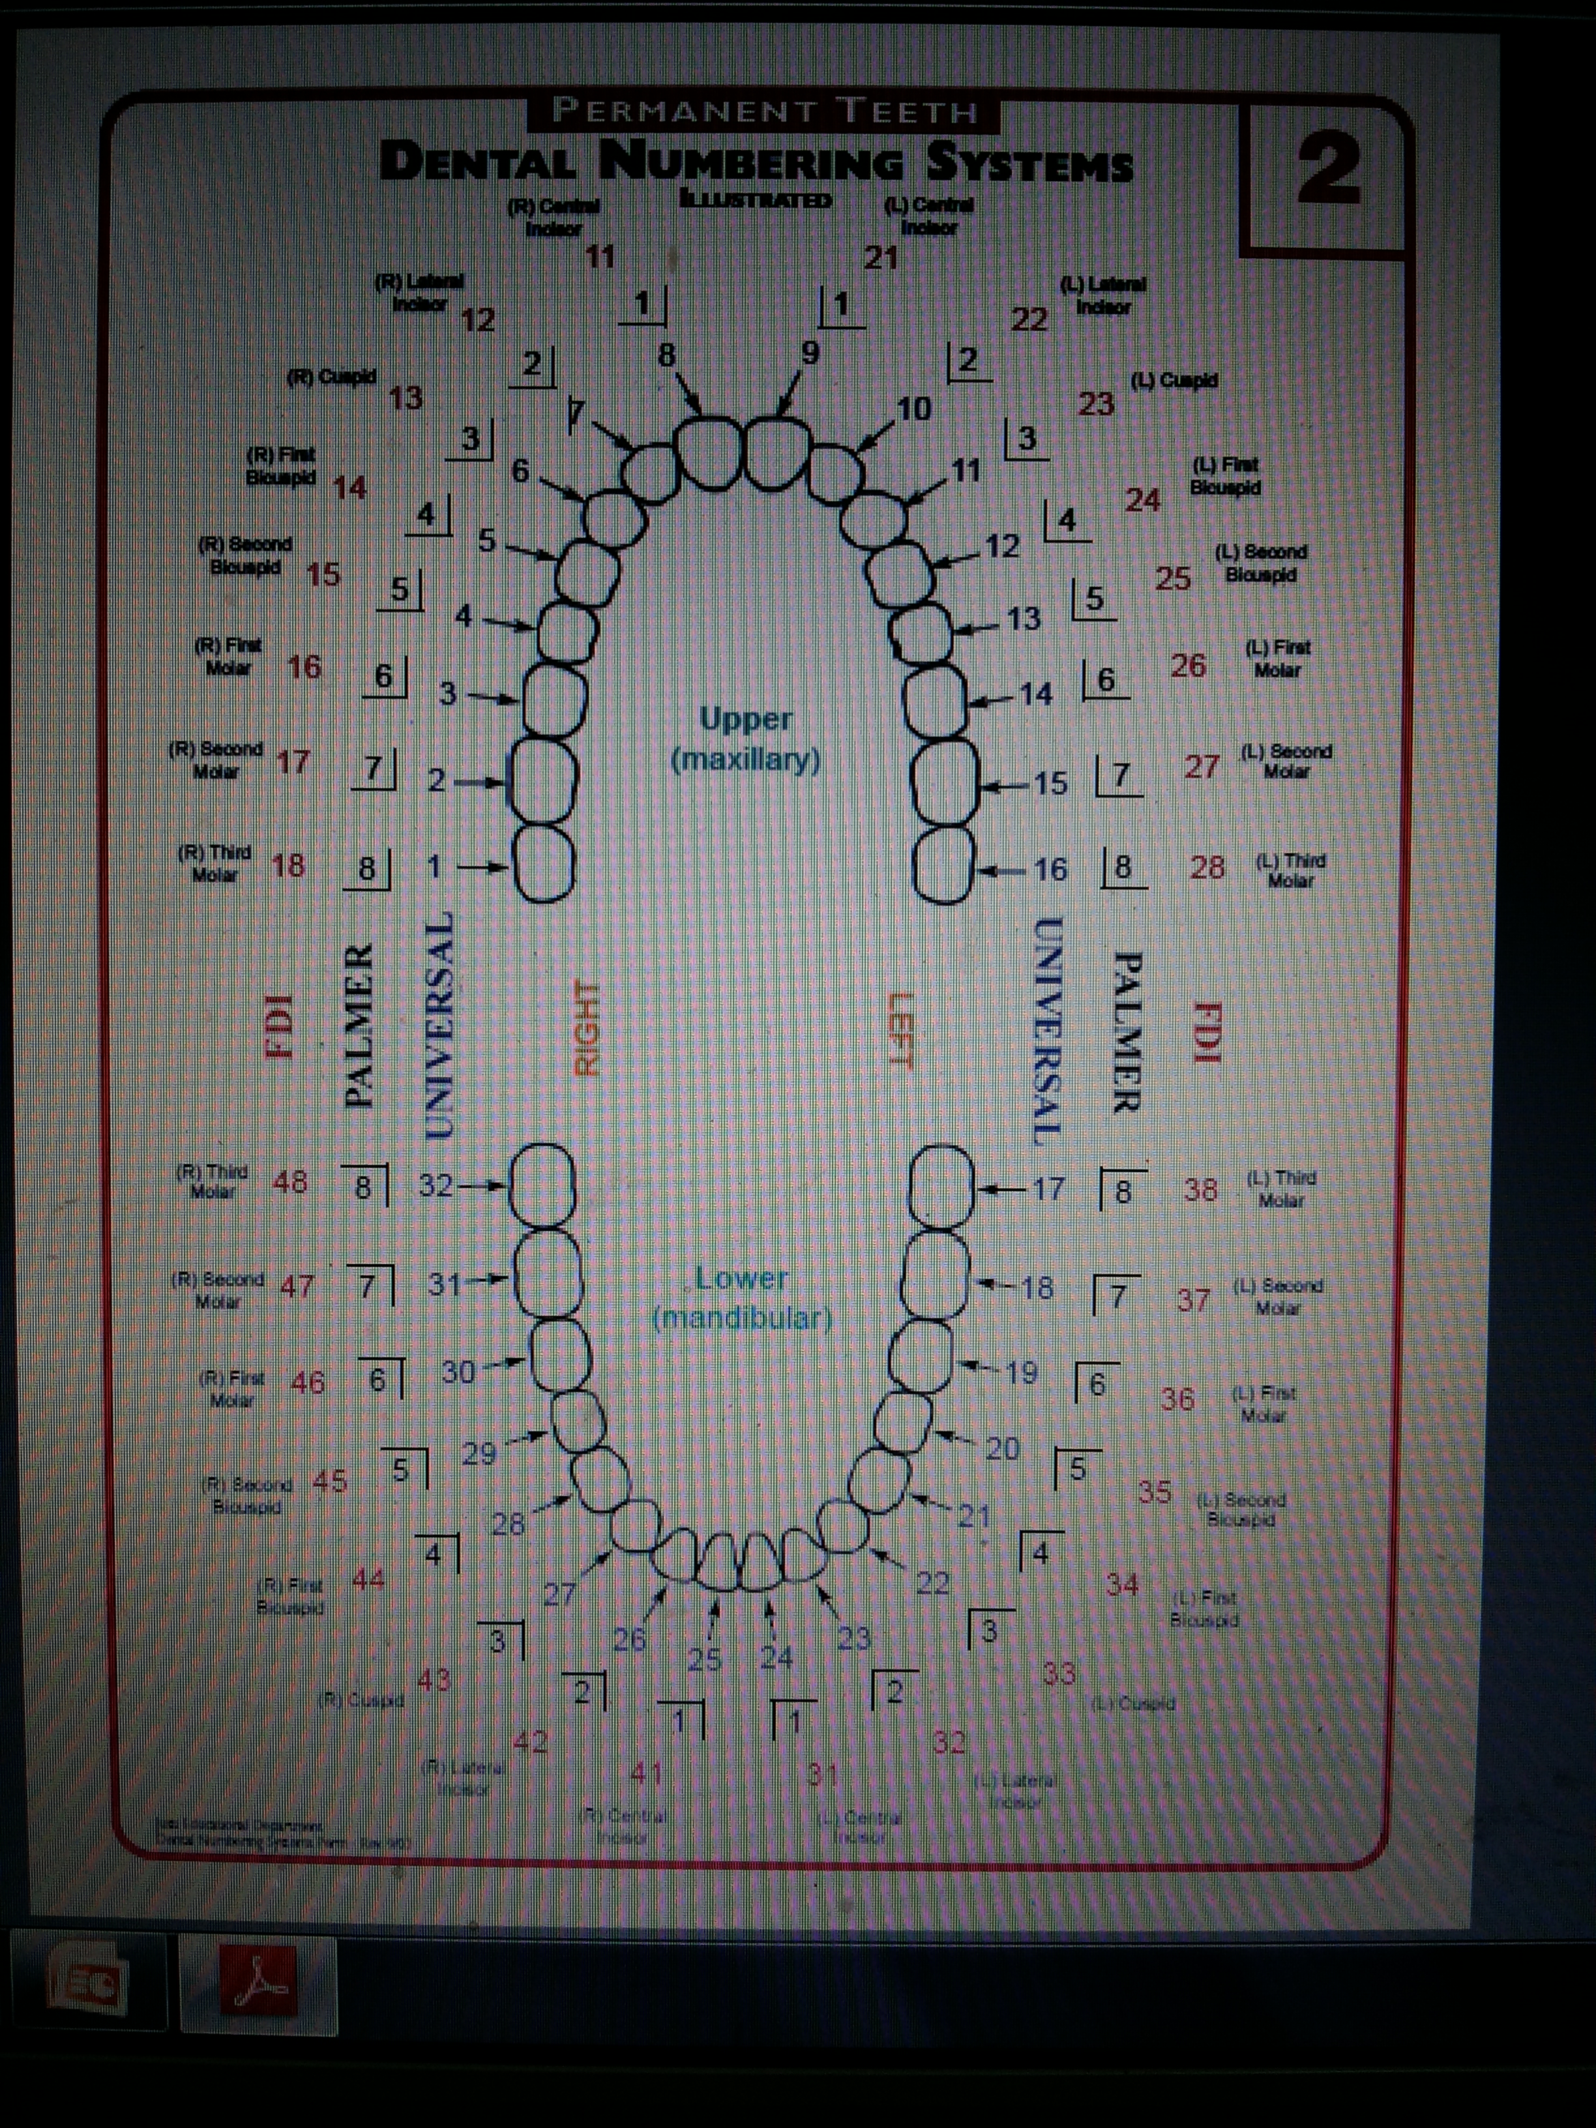

Slide 81
Summary/take home message
In conclusion, this chapter presented an overview of tooth morphology. First, nomenclature was defined and then tooth numbering systems were described. After this, the anatomy of the crown and root, as well as explanations of the tooth surfaces and ridges were presented. In order to grasp the morphology of the human tooth, it is necessary to understand the stages of tooth development. These stages give rise to the final morphology of a variety of human teeth with different surfaces and ridges, which are named using an entomologic system, and enumerated using numbering systems. This chapter provides a guide to the various stages of tooth development and the tissue composition of teeth at various stages of development, and provides insight into the vocabulary and numbering systems used to identify and describe human teeth

Slide 82
FAQs
Mention about parts and structure of tooth
Write in detail about different classes of teeth
Functions of teeth (in general)
Functions of specific class of teeth (incisor, canine, premolar, molar)

Slide 83
References
SN Bhaskar . Orban’s ,Oral Histology and embryology. 11th edition, Mosby 1998
Neville BW ,Damm DD ,Allen CM ,Bouquot JE . Oral and maxillofacial pathology , 2nd Edition .Philadelphia W.B. Saunders ;2002
Richard Tencate , Oral Histology development ,structure and function . 5th Edition ,1998
Carranza F.A., Michael G. Newman . Clinical periodontology 8,9,10th edition

Slide 84
THANKYOU

